Slide 1
DOGESH BHAI
THE MAGICAL DOG

Slide 2
WHO IS DOGESH
Dogesh bhai is a creature born in macroverse before the humanity existed. He is known for his power to make any good thing into bad thing (called kand).so , when I got to know about that I named my society’s street dog as dogesh.
he became the most powerful mafia of my society. Runned behind children to scare them .

Slide 3
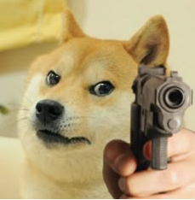
SOME PICS OF DOGESH BHAI

